Slide 1
Clade Template
From Andrew Lyman-Butler
http://ismscience.org/files/apbio/homework/cladebook%20template.pptx
See page 2
Example from same source:
http://ismscience.org/files/images/cladebook%20mammalia.png
See page 3

Slide 2

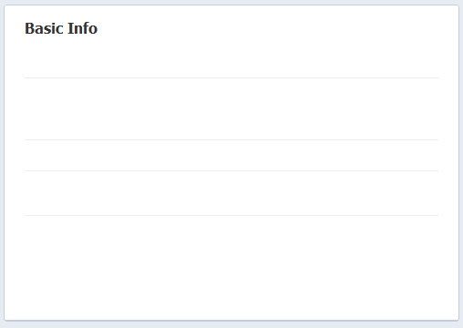

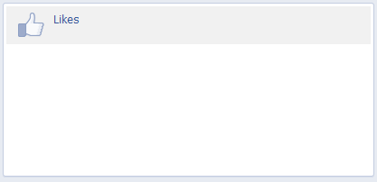
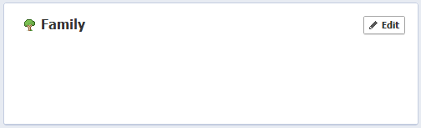
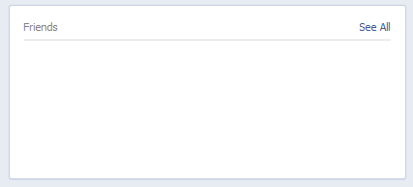
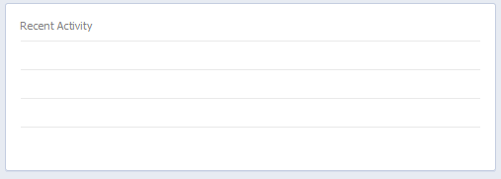
cladebook
Evolve | Find friends | Home
Clade name here
Birthday: ___
Defining characteristics: ___
Body cavity: ___
Germ layers: ___
Symmetry: ___
Reproduction: ___
Major sub-taxa: ___
Favorite food(s): ___
Clade name
Relationship
Clade name
Relationship
Something you like
Something you like
Something you like
Something you like
Friend Name
Network
Friend Name
Network
[Clade name] likes ________.
[Clade name] changed its [profile data to ___].
Friend Name
Network
Friend Name
Network
[Clade name] and [other clade name] are now friends.
[Clade name] is attending [event name].

Slide 3
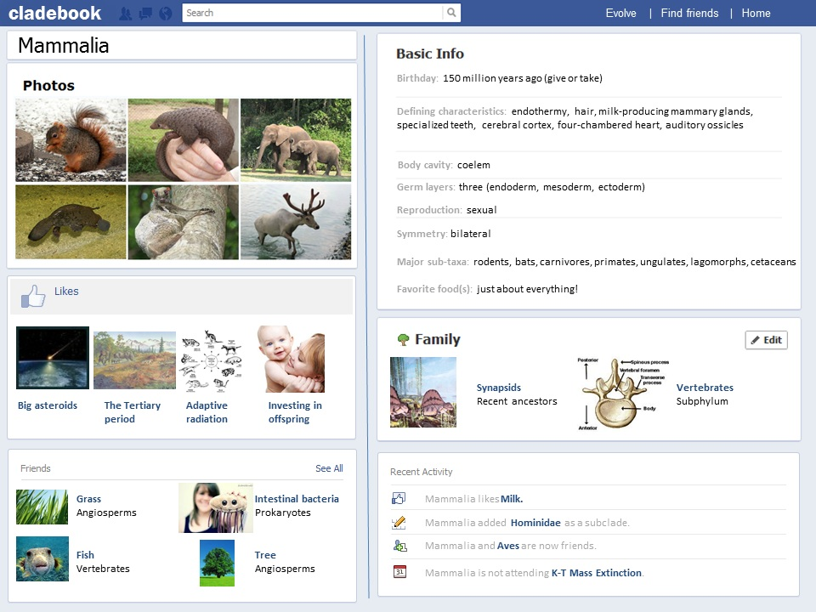
Example

